Slide 1
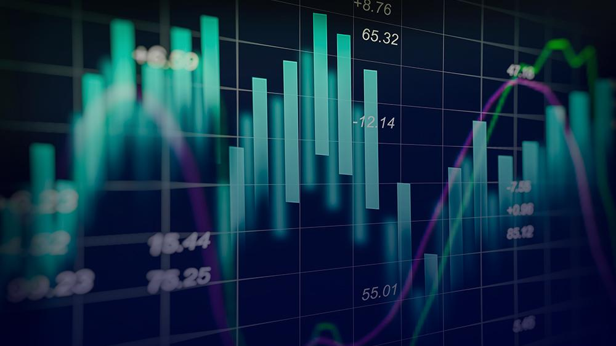

INVARJAN:
Investment planning and Tax automation using RL
GROUP NO. 6
Jayesh Bapu Ahire - B150234209
Atharva Abhay Karkhanis - B150234291
Ishana Vikram Shinde - B150234390
Satyam Kumar - B150234381

Slide 2
Content
Introduction
Solution
Literature
Design
Problems
Demo
Objectives
Limitations
Future Scope
Conclusion

Slide 3
INTRODUCTION

Slide 4
Along with Tax Automation, Investment Planning and Portfolio Management are also some of the areas where AI can be useful. Better investment decisions come, in part, from more precise asset pricing. More-in-depth analysis provides more accurate inputs for valuation models. AI’s freedom from emotions and behavioral biases leads to better investment decisions. Moreover, AI also helps us in managing Portfolios in a better way to reduce risks and to improve profits.

Slide 5
SN. | RESEARCH PAPERS REFERRED | AUTHORS | SEED IDEA
1. | Semantic Segmentation | Alexander Alemi, Paul Ginsparg | This paper identifies the best algorithm for text segmentation. Content Vector Segmentation is found out to be the best.
2. | Portfolio Management using Reinforcement Learning | Olivier Jin, Hamza El-Saawy | Accurate stock market predictor using Q-learning. Q-learning provides the added benefit of balancing between ’exploration’ and ’exploitation’ in order to provide the most optimal outcome.
3. | Stock Trading with Recurrent Reinforcement Learning (RRL) | Gabriel Molina | In this paper, an asset trader has been implemented using recurrent reinforcement learning (RRL). It is a gradient ascent algorithm which attempts to maximize a utility function known as Sharpe’s ratio.
4. | Deep Direct Reinforcement Learning for Financial Signal Representation and Trading | Yue Deng, Feng Bao, Youyong Kong, Zhiquan Ren, and Qionghai Dai | Recurrent deep neural network (DNN) for real-time financial signal representation. Implements DL along with RL.

Slide 6
Learnings from literature
Better investment decisions come, in part, from more precise asset pricing.
More-in-depth analysis provides more accurate inputs for valuation models.
AI’s freedom from emotions and behavioral biases should also lead to better investment decisions.
Behavioral biases will continue to influence our investment decisions, often to our detriment.

Slide 7
The above learnings give us answer to a very important question Why AI?
Deeper Analysis
Better Decision
Modularity
Adaptability

Slide 8
PROBLEMS?

Slide 9
Problems Identified
Complex Tax Infrastructure and high cost for CA.
Change in ITR forms every year.
Less knowledge of investment options available to middle class people (Lack of financial literacy)
Volatile market.

Slide 10
MOTIVATION
The above learnings and problems identified motivated us to achieve the following:-
Educate people about the complex Tax structure as well as increase their Financial literacy.
Encourage more people to pay taxes by guaranteeing them fixed profitable returns.
Helping people through the taxation process and providing them assistance with their Portfolio Management.

Slide 11
Objectives
To reduce the complexity of taxation process
To create a robust adaptive system which can motivate people to pay taxes and manage their own portfolio.
1
3
2
To create an all inclusive integrated platform for financial assistance.
4
To enhance accessibility of financial services.

Slide 12
Problem Statement
To build a simplified platform using RL to help making complex financial services accessible to everyone.

Slide 13
FRAMEWORK - DJANGO

Slide 14
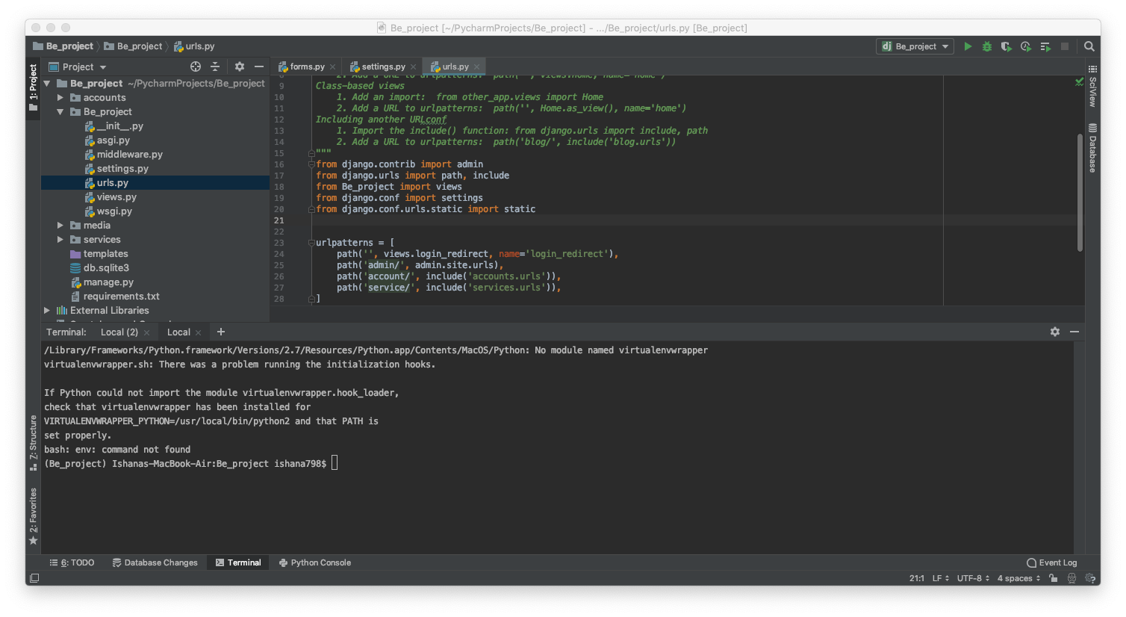

Slide 15

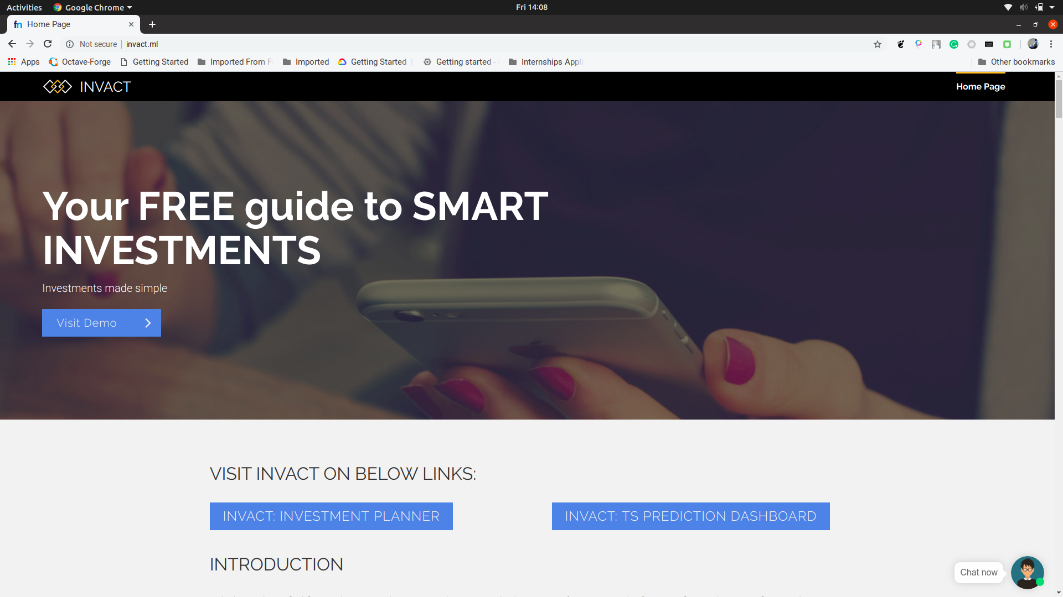
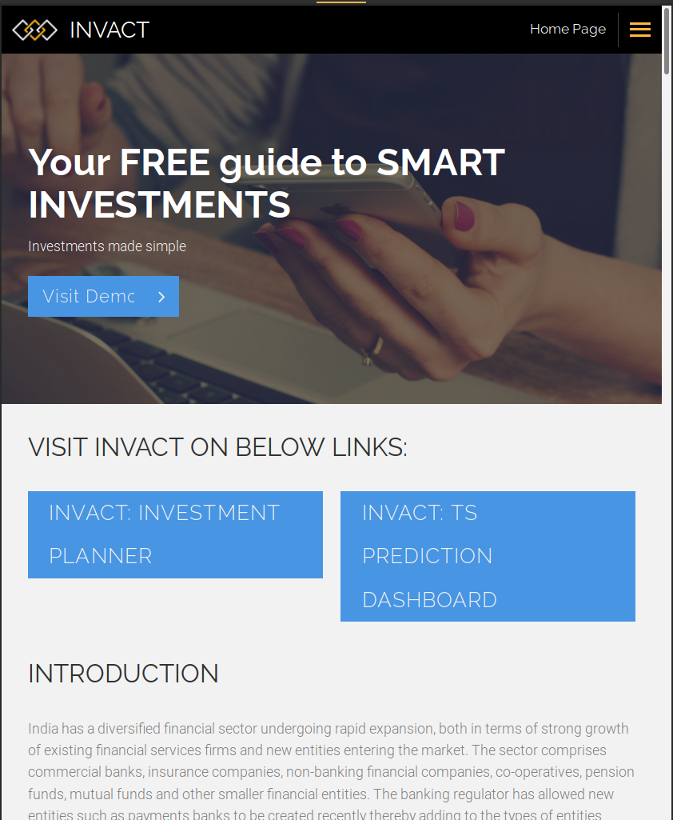
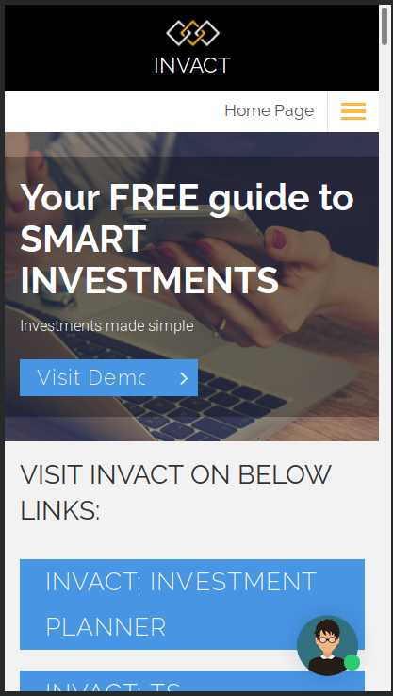
The solution
InvArjan is a complete online platform which can provide you tax automation and Investment Planning completely backed by advanced AI algorithms.

Slide 16
The solution
Tax automation part accepts pdf/photo of Form-16 as input and does the following procedure.
We use supervised learning in beginning to achieve tax calculation results and we can convert it to unsupervised in later stages.
Understanding all clauses and insights of the taxation process is critical in this.
Tax Automation

Slide 17
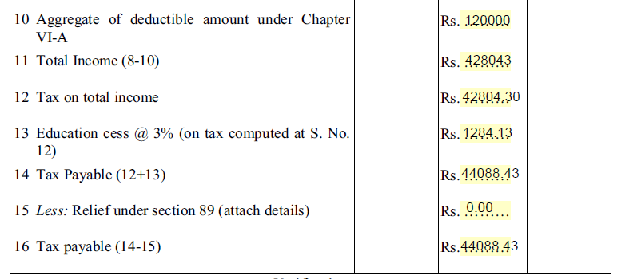
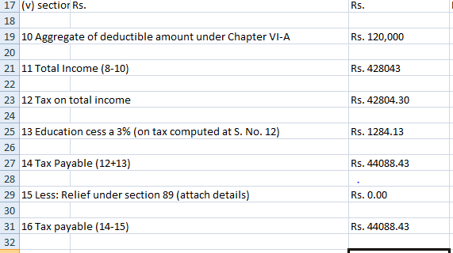
ACTUAL PDF
DATA EXTRACTED CSV FILE

Slide 18
INPUT AND OUTPUT
INPUT :- Provide a pdf/jpeg/png format of the Form 16
OUTPUT :- We get 3 different formats of o/p
CSV file with the extracted text
JSON file with the extracted data along with the word-numeric mappings
Text file of the extracted data

Slide 19
ADVANTAGES OVER CONVENTIONAL OCR
Following are the advantages of Table discovery over conventional OCR :-
Does not follow rigid tabular grid structure like OCR
Unlike OCR can detect words, numerics as well as tables and lines
Word-numeric mappings are formed like Parent-child mapping; helps in preserving the contextual integrity of the data.
Real time training possible because of AWS.
Possible to extract data from various file formats like pdf, jpeg, png; a trait lacking in the conventional OCR’s.

Slide 20
The solution
A portfolio is a grouping of financial assets.
Portfolios are held directly by investors or managed by financial professionals.
Investors can construct an investment portfolio in accordance with their risk tolerance and their investing objectives.
Educate the user and provide right tools in their hands.
2. Portfolio Management/ Investment planning:

Slide 21
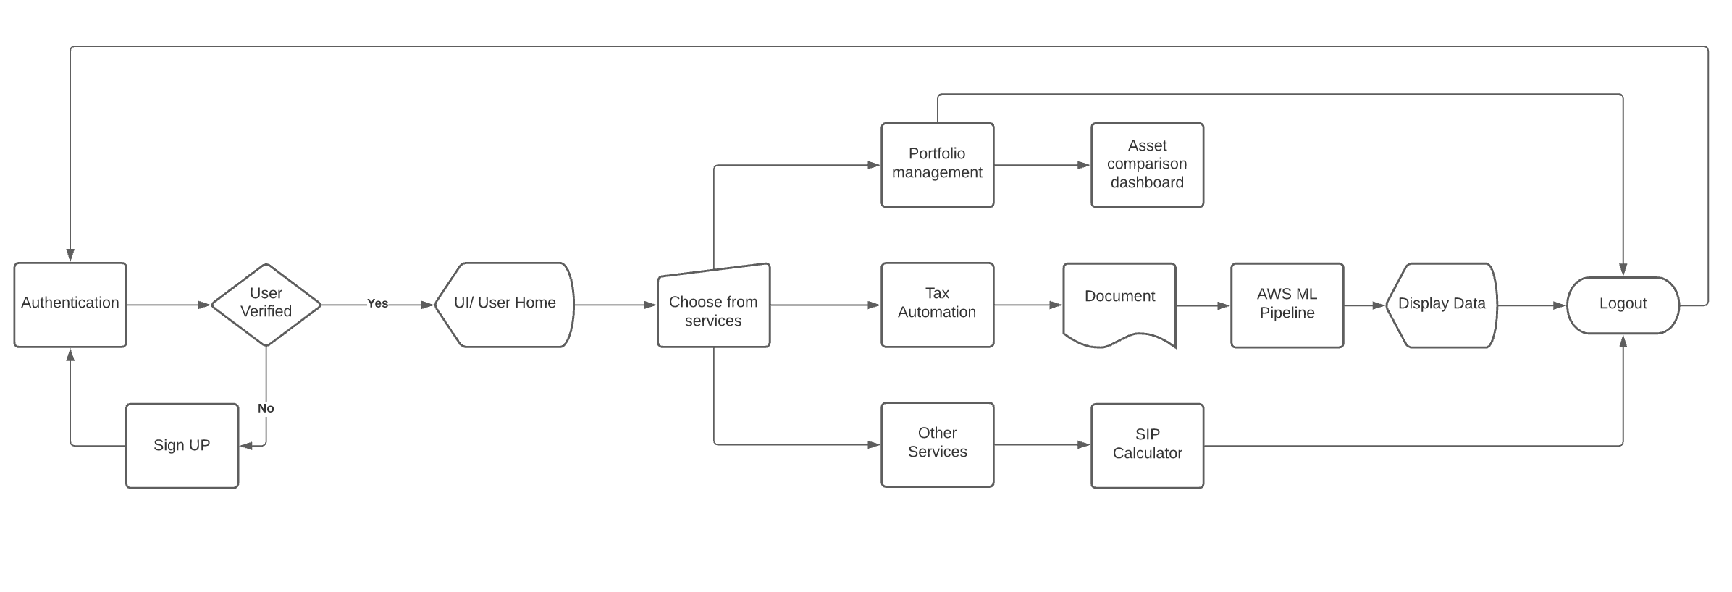
How it works

Slide 22
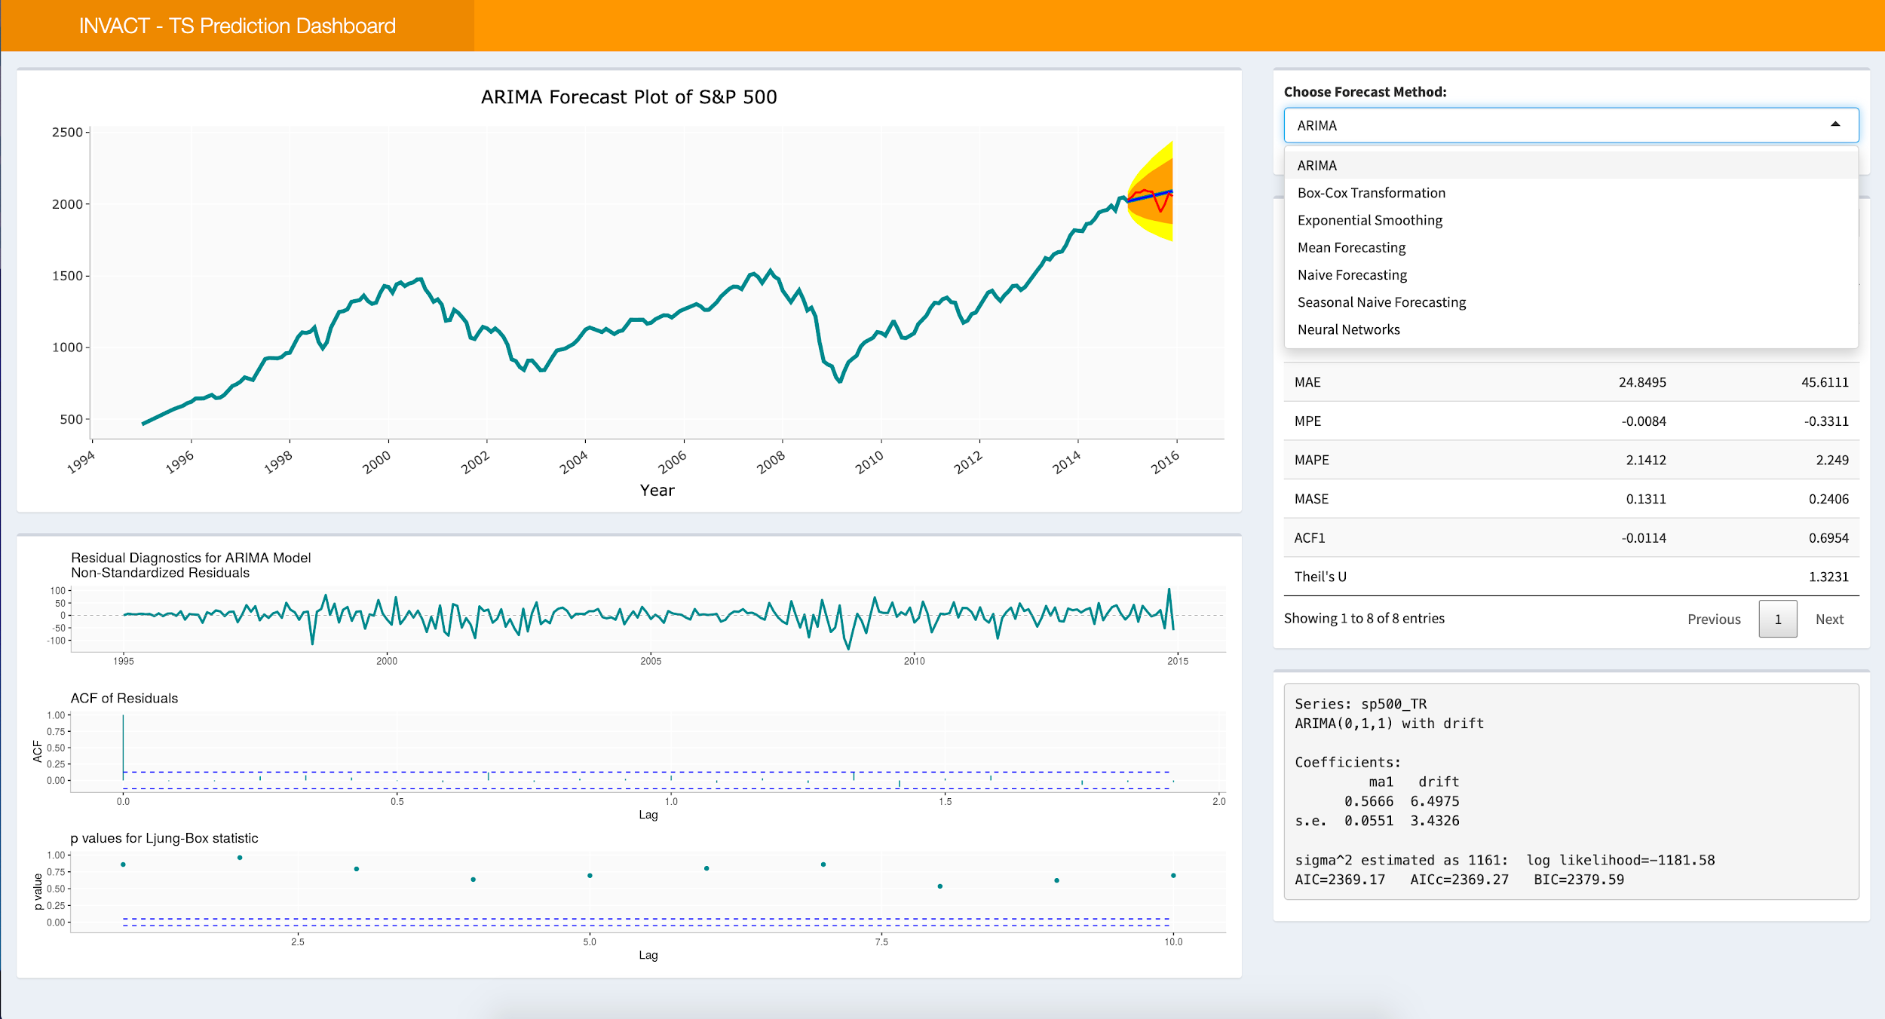

Slide 23
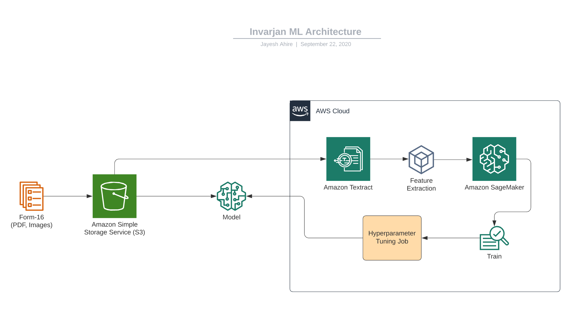

Slide 24
Technology Stack
Platform:
AWS
Additional Web Components
Django
Tax Automation
Semantic segmentation
Sagemaker + Textract
Investment Planning
Real time data
R
ARIMA

Slide 25
Other Services
Accumulation SIP:
Same amount invested recursively from starting to end.
Doesn’t consider annual inflation and your salary increment.
Top-Up SIP:
Investment amount incremented on annual basis.
Helps you invest more, save more and give exponential returns in end.
SIP Calculator:

Slide 26
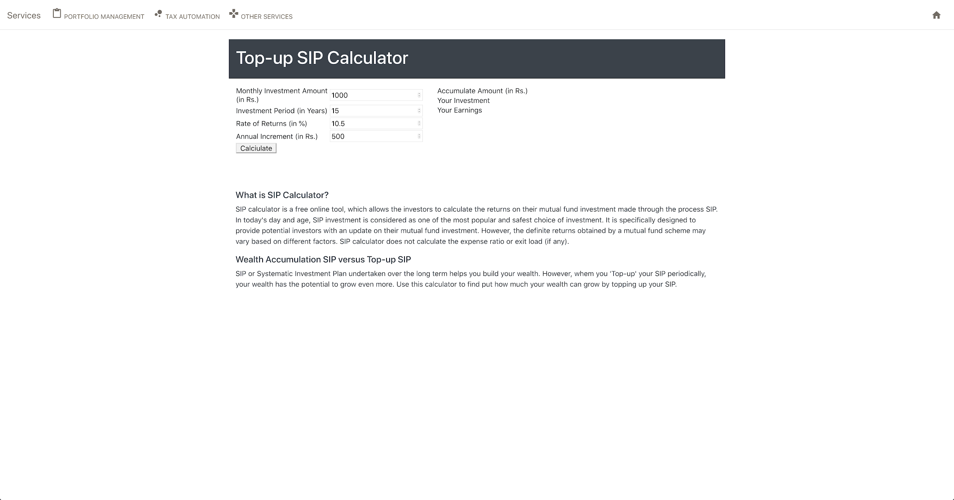

Slide 27
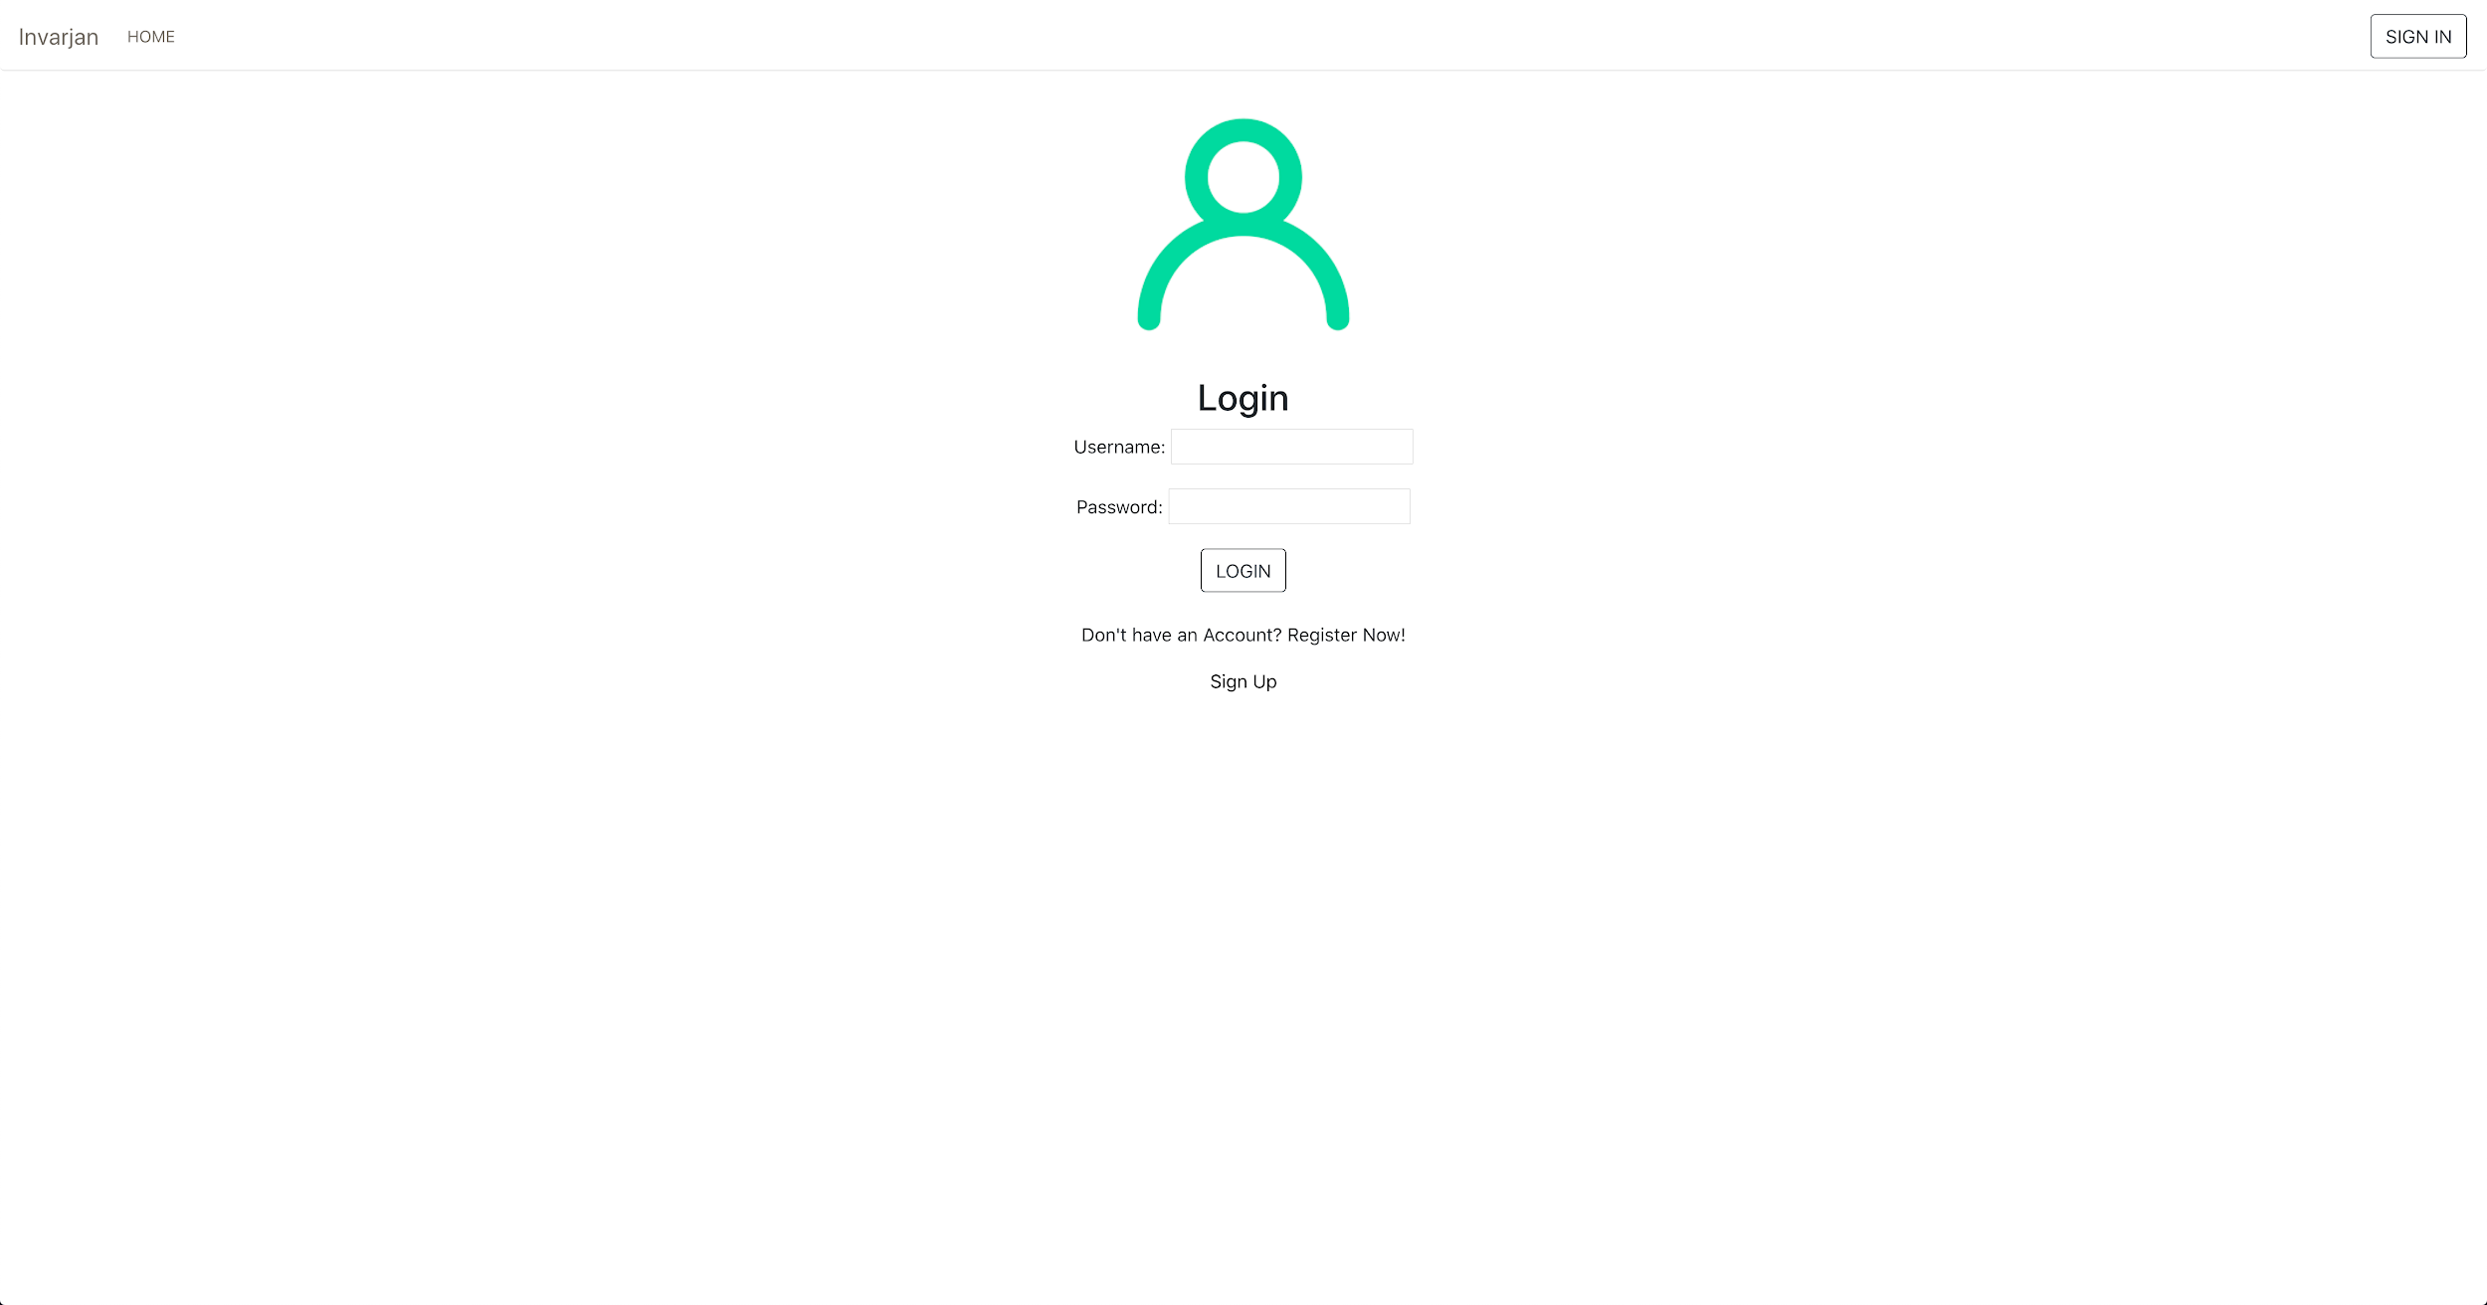

Slide 28
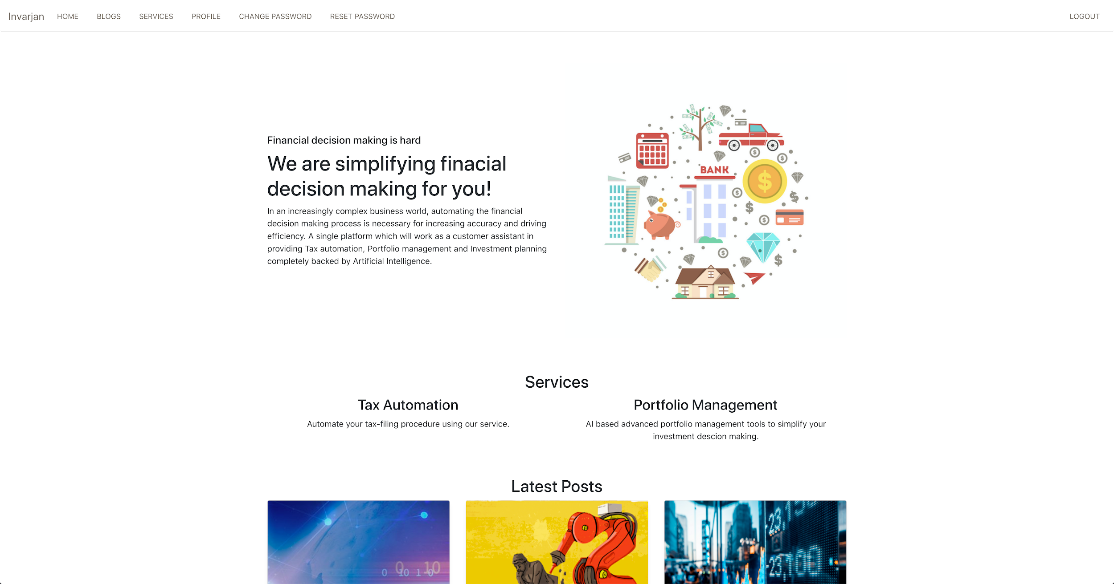

Slide 29
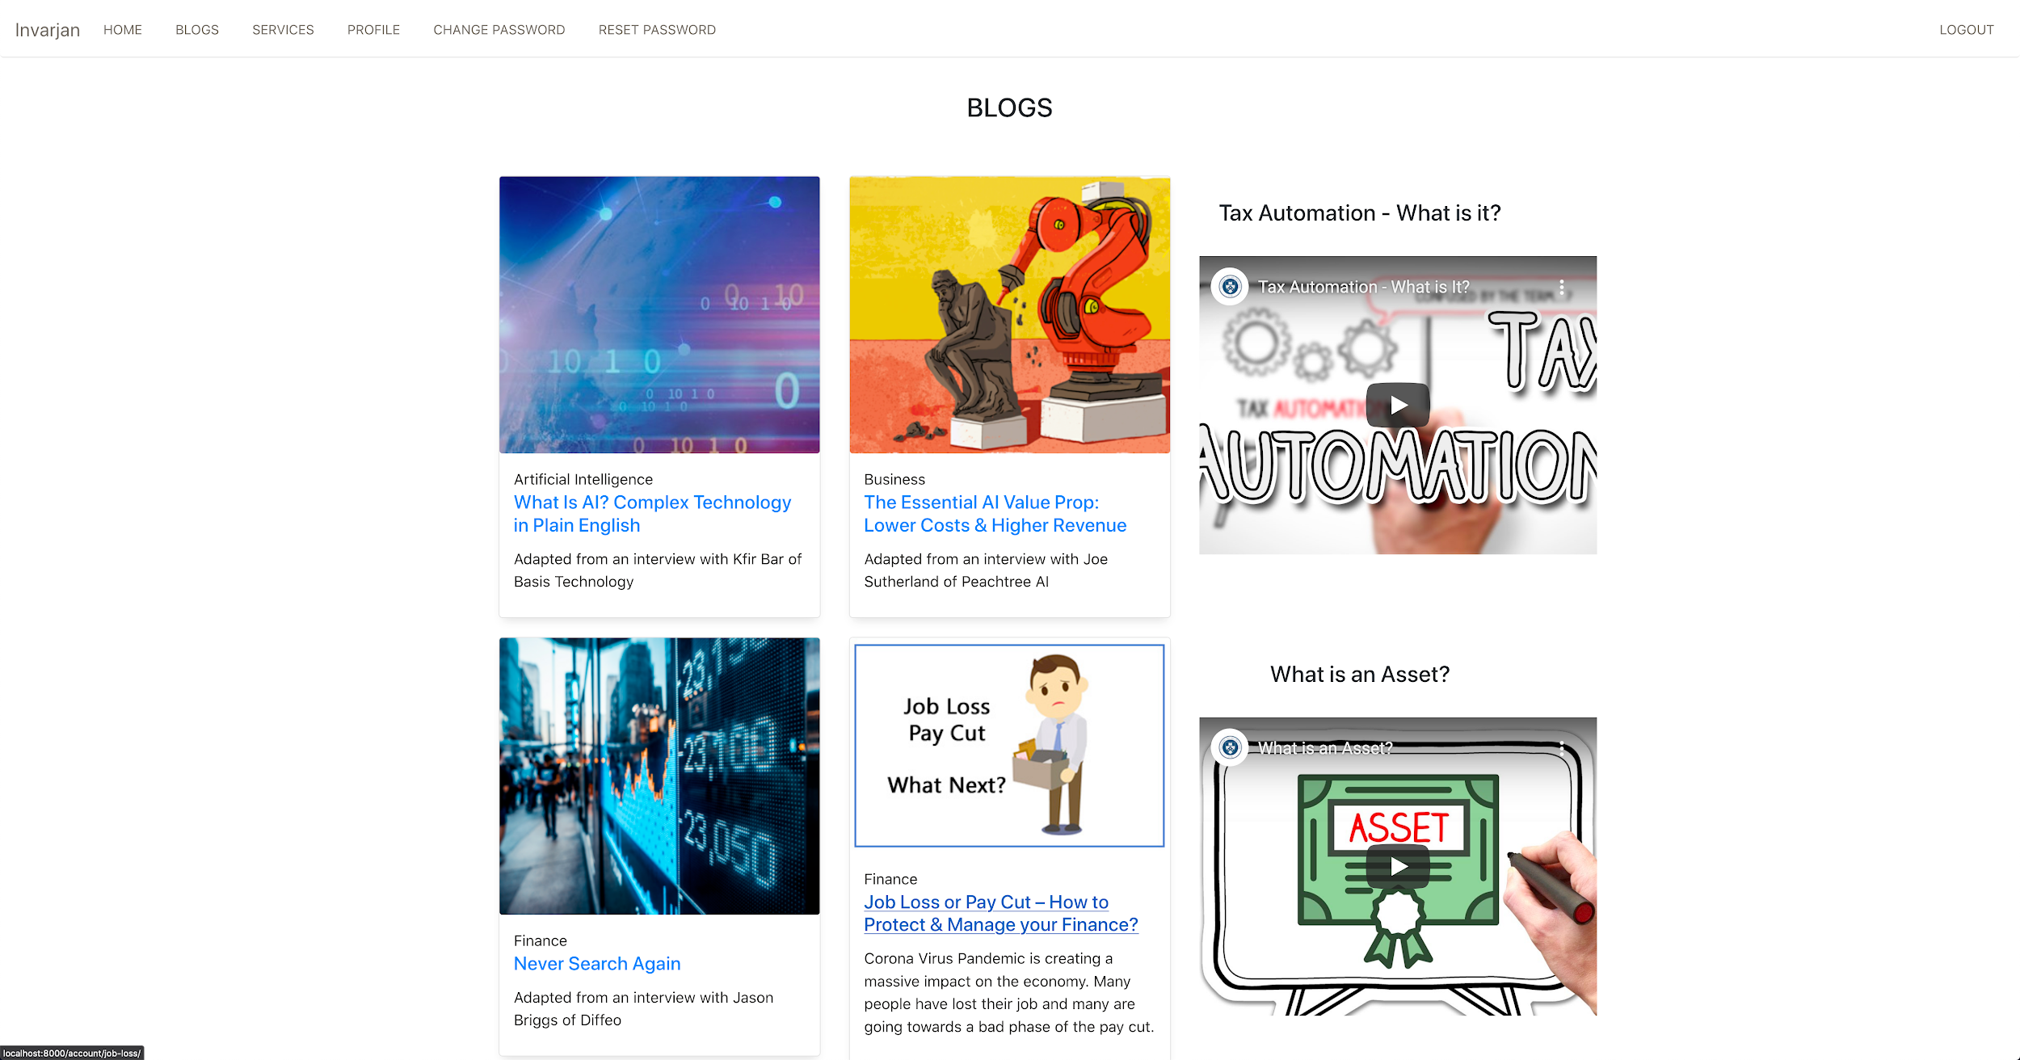

Slide 30
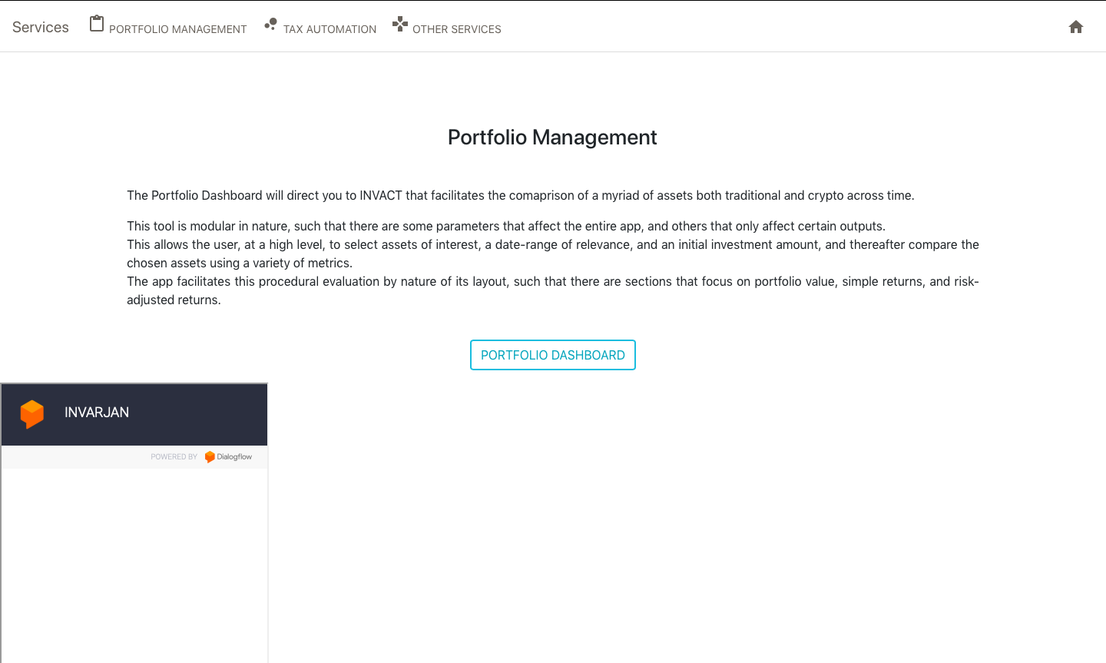

Slide 31
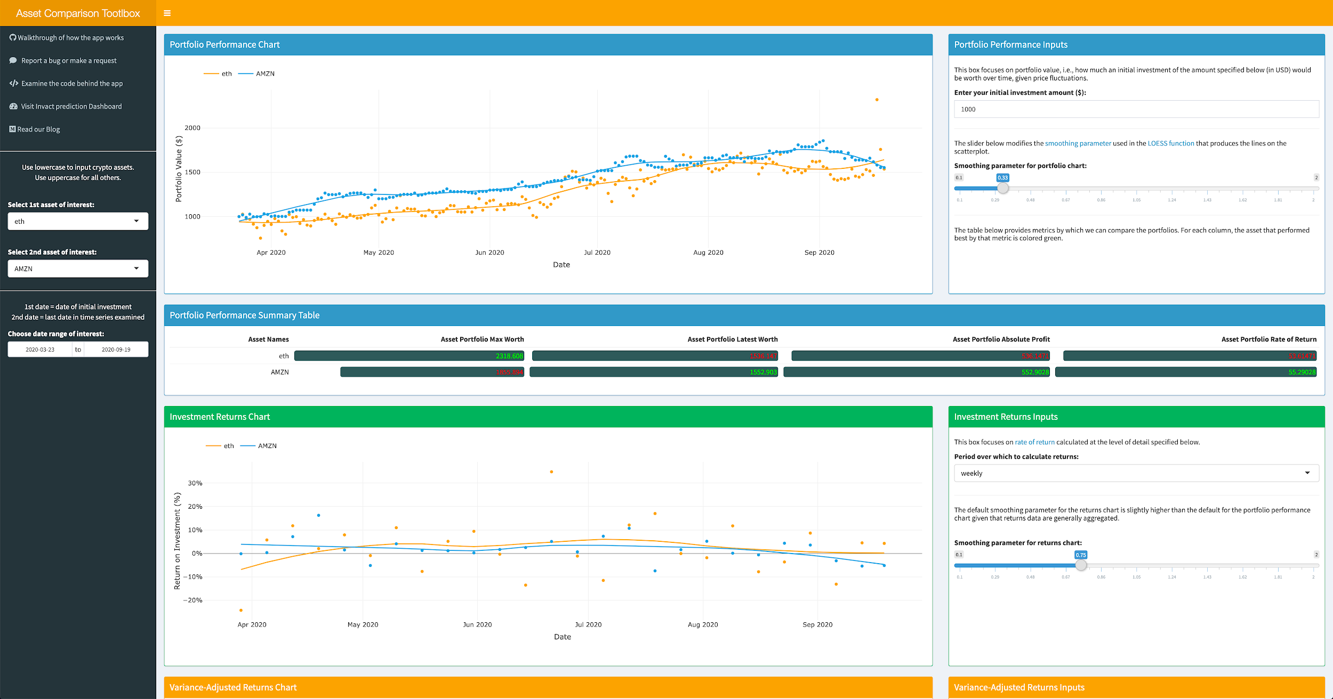

Slide 32
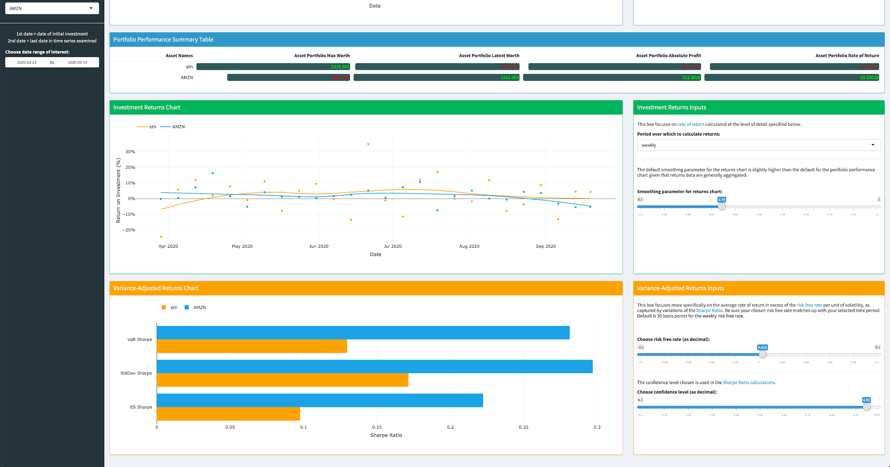

Slide 33
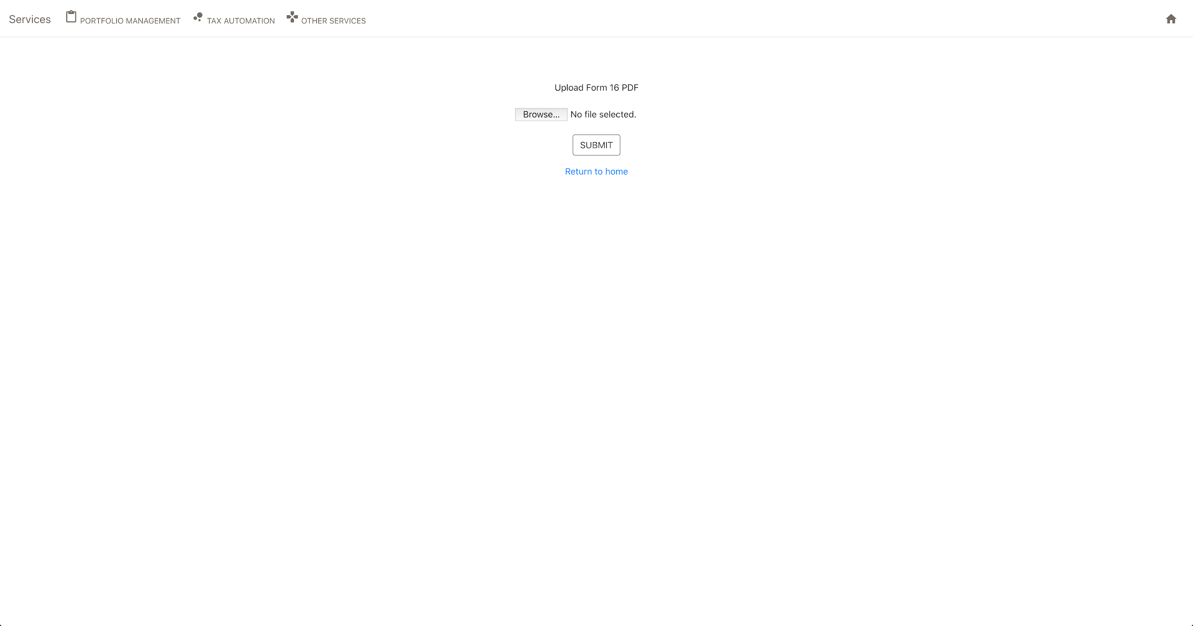

Slide 34


Slide 35
Limitations
Even though the table discovery model works well for typed documents or photos, it sometimes fails to recognise handwritten documents.
Even though we are working with a diversified group of assets, we would like to add few more assets and certain crisis management investment plans to the model.
Current system caters well to the salaried population only.
The current system is not able to tackle unannounced market risks eg: Covid19 impact on the market.

Slide 36
Future Scope
Enhancing the capability of the Table discovery model to accommodate handwritten documents efficiently.
Expanding the asset collection with few more assets.
Expanding the customer base to businesses as well.
Making the model robust to handle unannounced risks.
Scaling up the prototype to accommodate higher traffic on the webApp.
Optimising cloud cost.

Slide 37
Conclusion
People in developing country like ours lack financial literacy and there are very few ways which enable them to be able to take decisions like investment planning.
Taxation is getting complicated over every year and our tax automation process paves the way for better solution in coming period as we solved really important problem of data extraction here.
This is not a user-ready project yet but it’s a step in a right direction.
Our tech stack is based on futuristic modular technologies and utilising them in right way will for sure help us in our goal to create a financial platform not everyone desires but everyone needs!

Slide 38
Thank you.

